Slide 1
Unsupervised Learning
Clustering
Mathematics 699
6/5/2019
Yuta Hayashi
IHRTLUHC

Slide 2
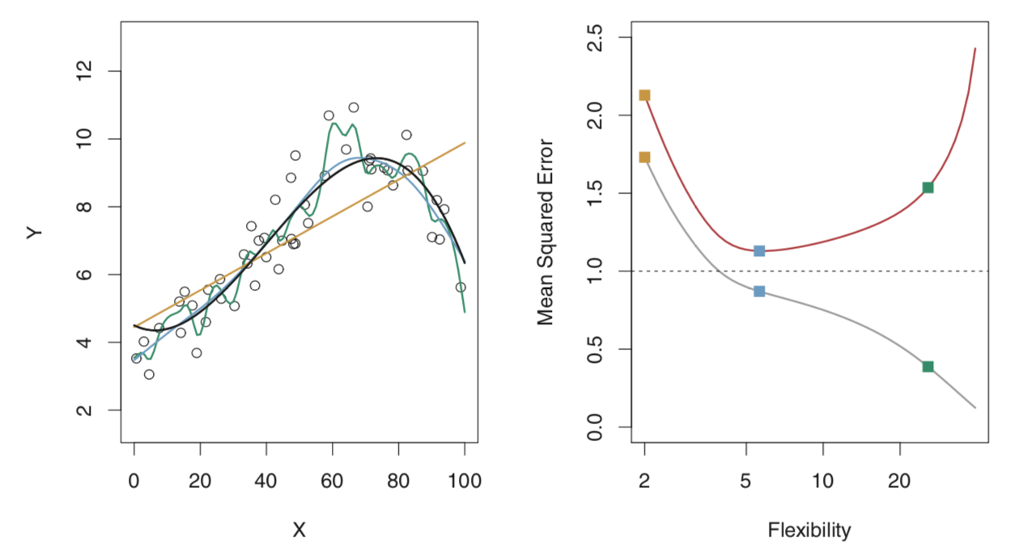
Machine Learning
Supervised Learning vs Unsupervised Learning
Training and test error
Variance-bias tradeoff
Cross-validation

Slide 3
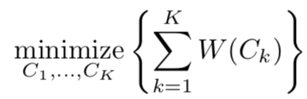
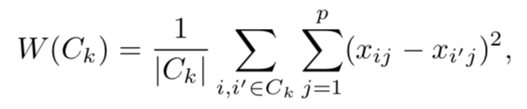
K-means Clustering
Objective:
Where

Slide 4
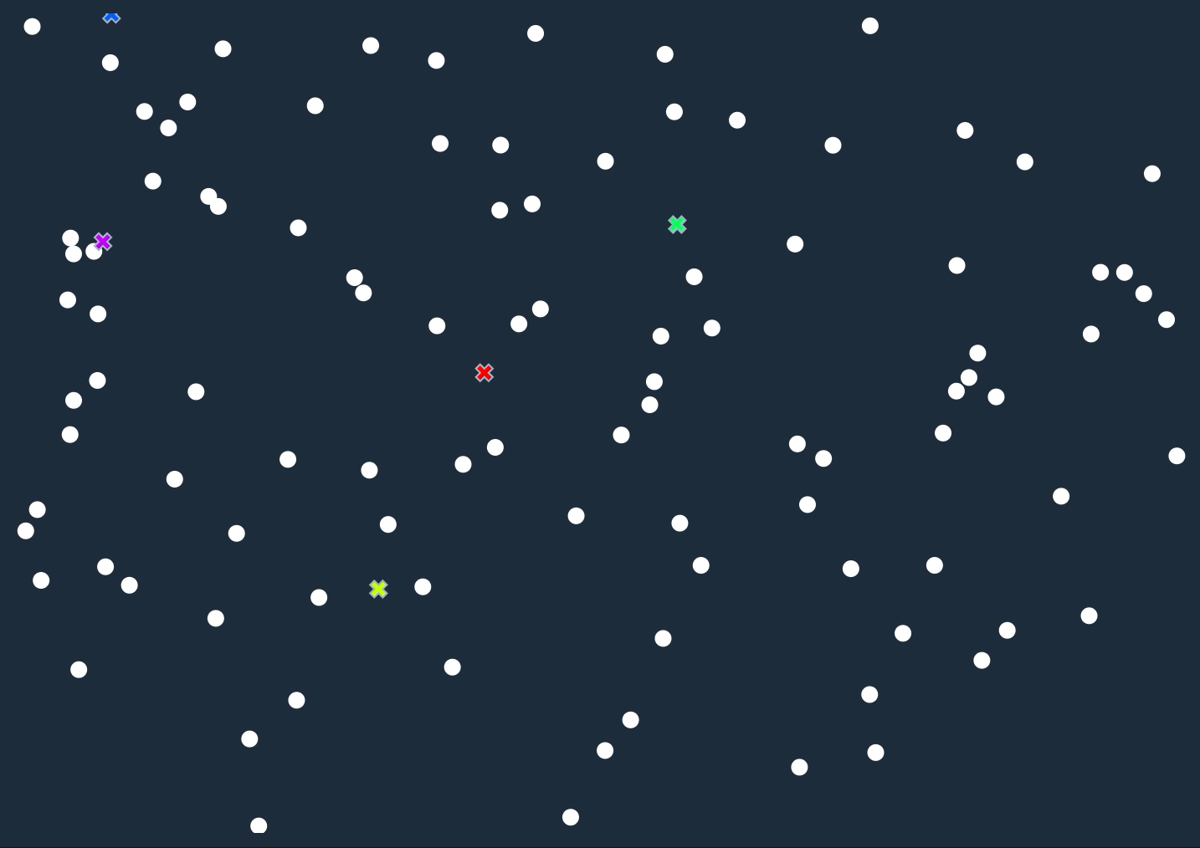
K-means Clustering
Algorithm
Initial Step: Randomly assign K centroids
Assign each observation to the cluster whose centroid is closest
For each cluster, compute the cluster centroids
Iterate I and II until the cluster assignment stays the same
Cited from
http://tech.nitoyon.com/ja/blog/2013/11/07/k-means/
Notes:
Predefined number of data
K-means clustering is a simple and elegant approach for partitioning a data set into K distinct, non-overlapping clusters.
a good clustering is one for which the within-cluster variation is as small as possible
The kth cluster centroid is the vector of the p feature means for the observations in the kth cluster.

Slide 5
K-means Clustering
Elbow Method
Scree plot:
Sum of Squares
1
2
3
4
5
# of clusters
Notes:
Best outcome is based on minimum total within cluster sum of squares
Supervised learning predict
Unsupervised learning interpretational

Slide 6
Hierarchical Clustering
2 clusters
3 clusters
5 clusters (each point)
1 cluster
4 clusters
Notes:
Next step is to find the closest two clusters and join them into a single cluster
This process continues iterately finding a next cluster that are close to each other
Continues until we get 1 cluster

Slide 7
Hierarchical Clustering
Dendrogram
distance

Slide 8
FIFA data
Collected from Kaggle database, FIFA 2018 season all over the world
18207 rows(Players) and 95 columns(Traits)
47 categorical 48 quantitative variable

Slide 9
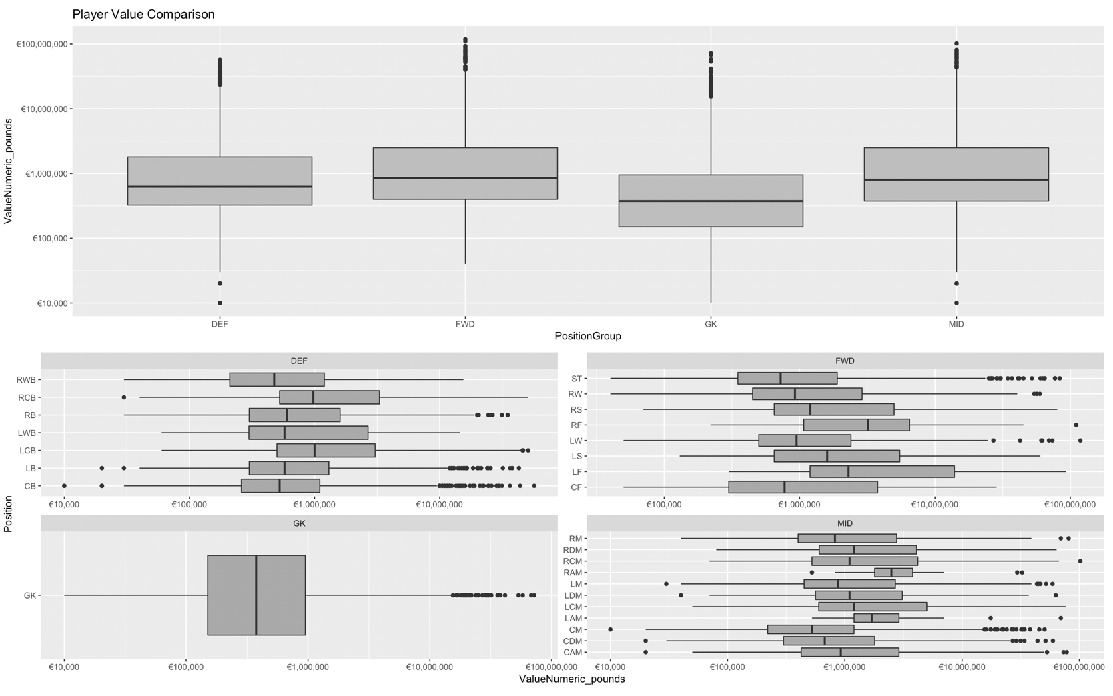
Quick View

Slide 10
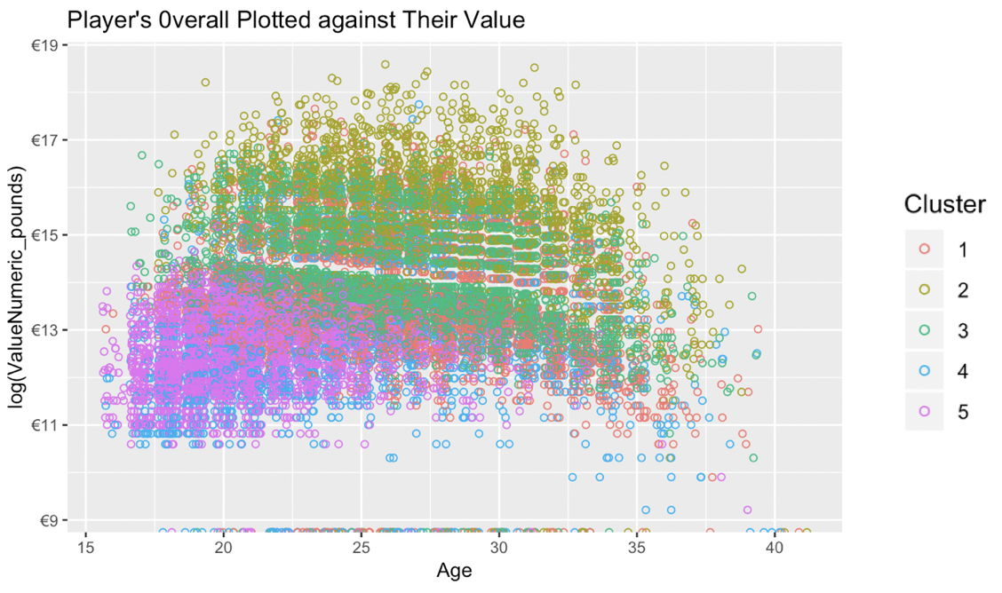
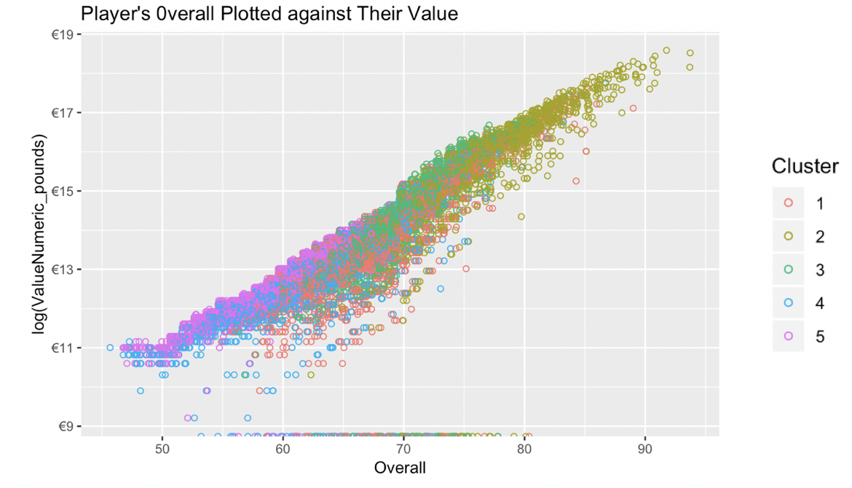
Clustering Analysis
 | Defender | Forward | Midfielder
Cluster 1 | 140 | 1351 | 1471
Cluster 2 | 499 | 284 | 1490
Cluster 3 | 2675 | 57 | 2047
Cluster 4 | 2537 | 8 | 204
Cluster 5 | 15 | 1718 | 1626

Slide 11
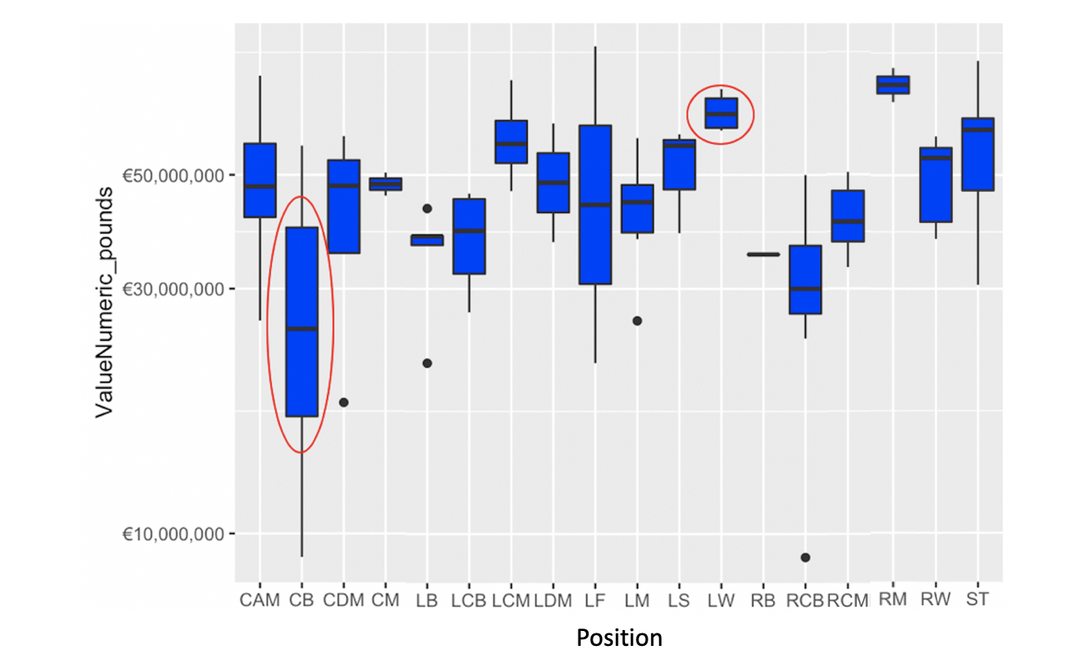
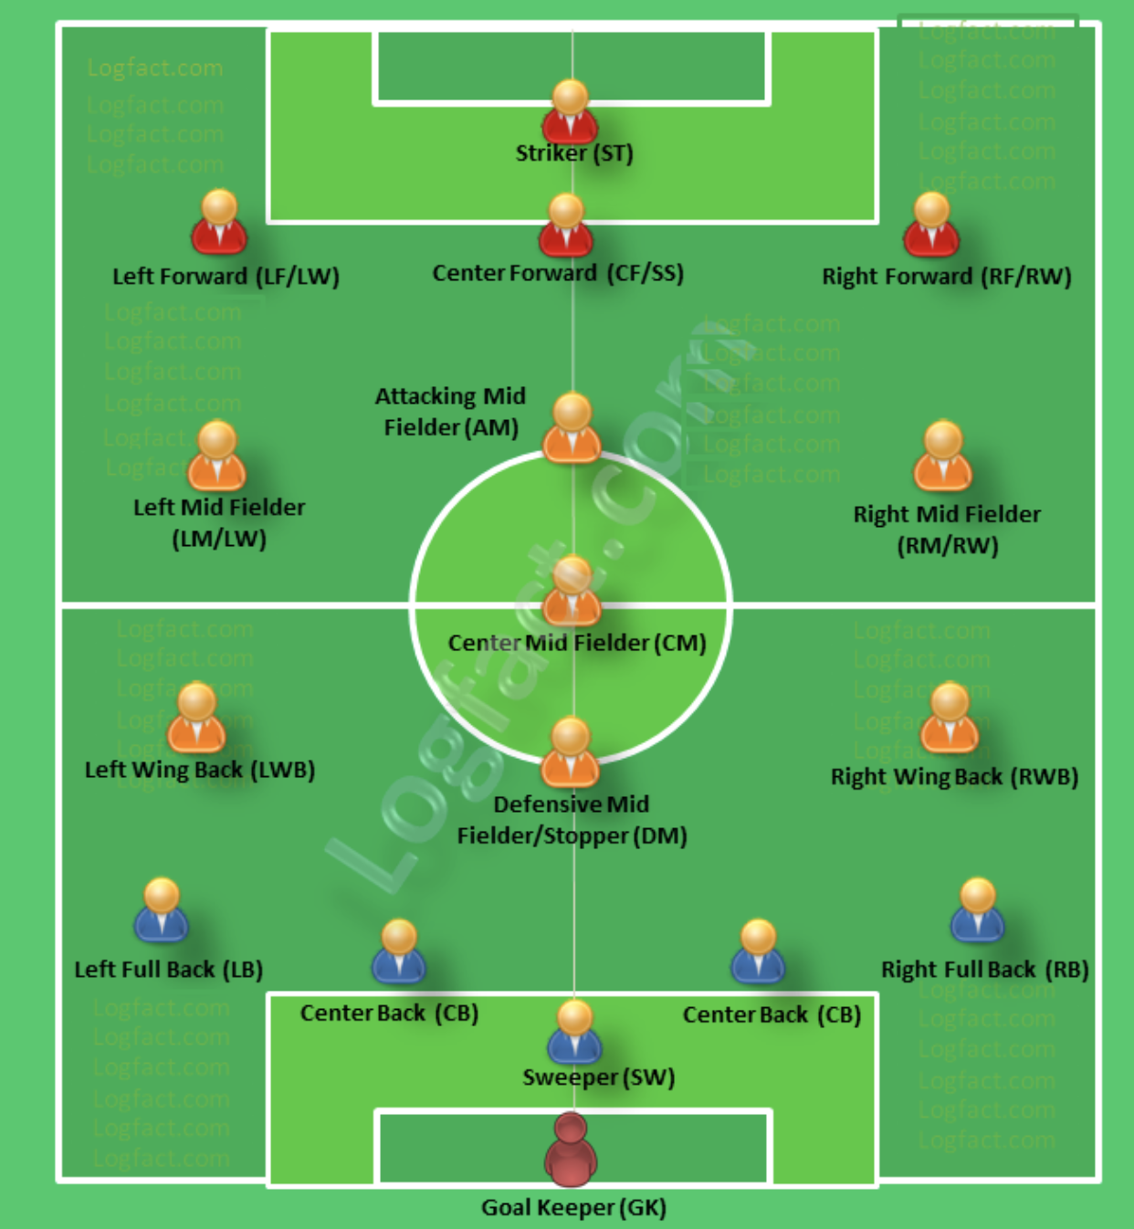
Over/Under Compensation get rid of small samples
Cited from http://logfact.com/football-soccer-field-player-positions-abbreviations/
Notes:
I tried to find dissimilarity but I couldn’t

Slide 12
Conclusion
Clustering is heavily based on compensation, overall ability, and positions
If you want to be the BEST player in the world, DON’T be a CB player

